Slide 1
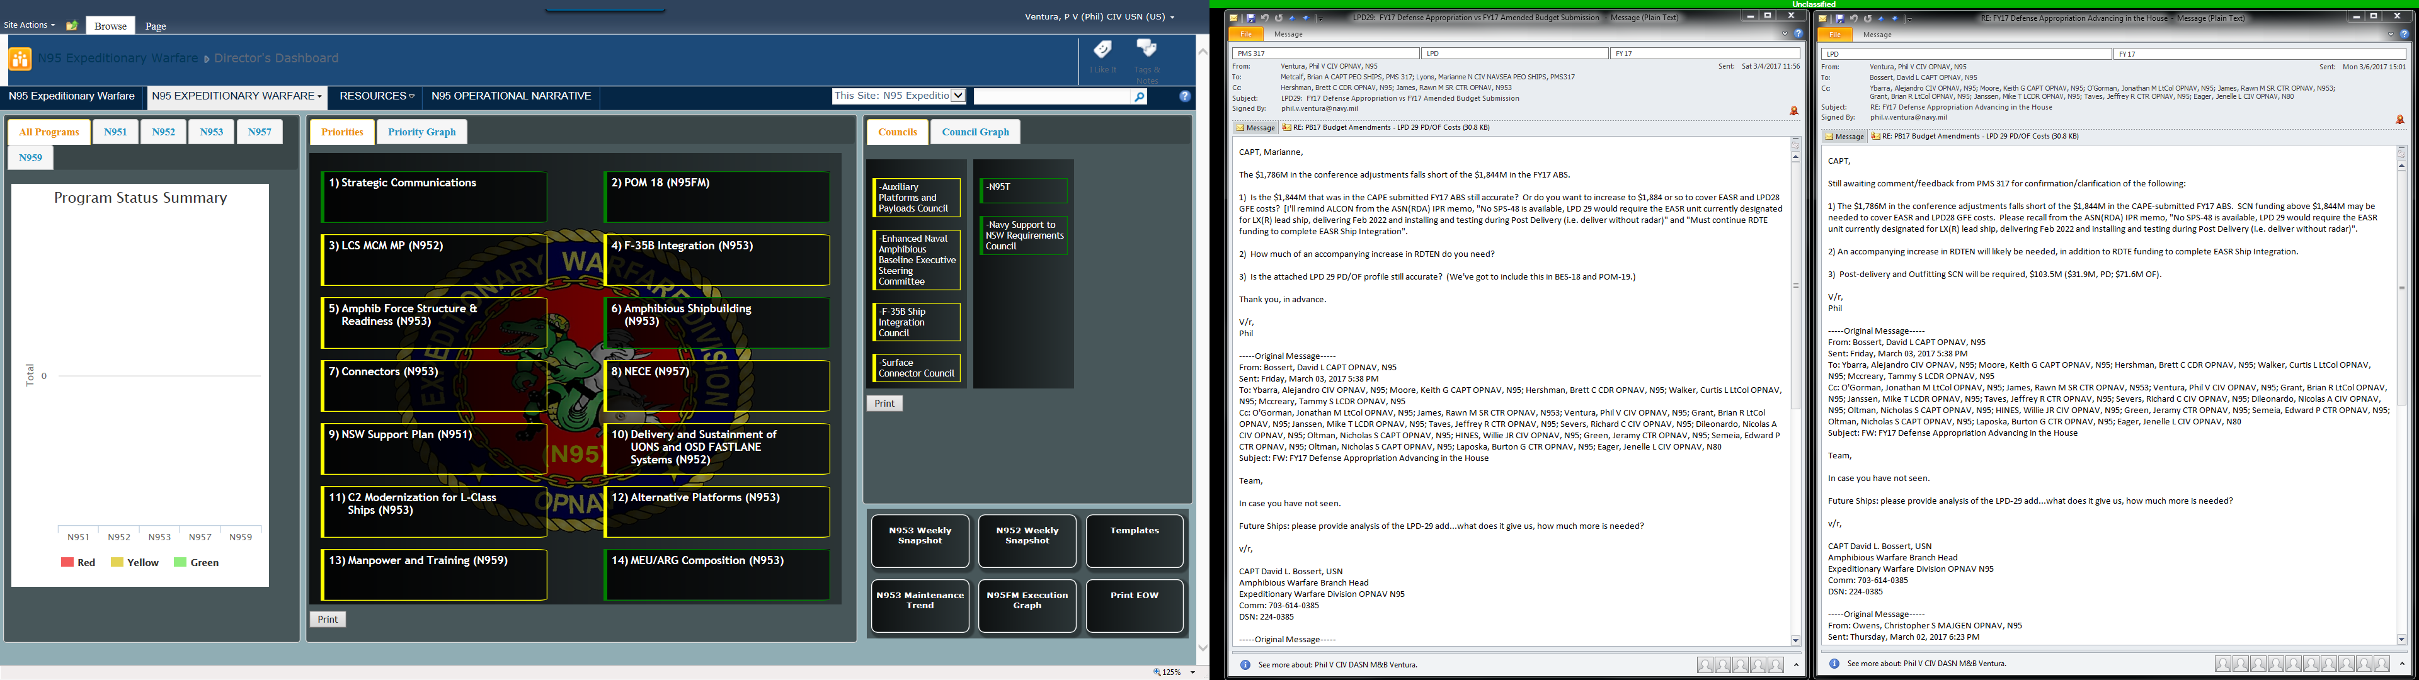
N95 JCIDS/Navy Capabilities and DAS Portfolio Summary
 |  | ACAT I | ACAT II | ACAT III | ACAT IV | Special Interest
Material Solutions Analysis
Technology Maturation & Risk Reduction
Engineering & Manufacturing Development
Production & Deployment
Operations & Support
ICD
MDD
AOA
DRAFT
CDD
A
CDD
LX(R)
SCX(R)
DEV
RFP
B
CPD
LHA(R)
ESB
LPD 17
SSC
C
Riverine

Slide 2
N95 JCIDS/Navy Capabilities and DAS Portfolio Summary
 | Material Solutions Analysis | Technology Maturation & Risk Reduction | Engineering & Manufacturing Development | Production & Deployment | Operations & Support
ACAT I
ACAT II
ACAT III
ACAT IV
Special Interest
ICD
MDD
AOA
DRAFT
CDD
A
CDD
DEV
RFP
B
CPD
C
LX(R)
LHA(R)
LPD 17
SSC
ESB
SCX(R)
Riverine
 | Program | Event | Program | Event | Program | Event | Program | Event | Program | Event
Next Event |  |  | SCX(R) |  | ESB |  | LHA(R) | TSST; Apr 1, 2017 | Riverine
 |  |  | LX(R) | Gate 4/5; Aug 1, 2017 |  |  | LPD 17 | Delivery; July 1, 2017
 |  |  |  |  |  |  | SSC
RED = OVERDUE

Slide 3
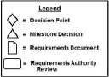
N95 JCIDS/Navy Capabilities and DAS Portfolio Long Range Calendar
FY15Q1 |  |  | FY15Q2 |  |  | FY15Q3 |  |  | FY15Q4 |  |  | FY16Q1 |  |  | FY16Q2 |  |  | FY16Q3 |  |  | FY16Q4 |  |  | FY17Q1 |  |  | FY17Q2 |  |  | FY17Q3 |  |  | FY17Q4 |  |  | FY18Q1 |  |  | FY18Q2 |  |  | FY18Q3 |  |  | FY18Q4 |  |  | FY19Q1 |  |  | FY19Q2 |  |  | FY19Q3 |  |  | FY19Q4
O | N | D | J | F | M | A | M | J | J | A | S | O | N | D | J | F | M | A | M | J | J | A | S | O | N | D | J | F | M | A | M | J | J | A | S | O | N | D | J | F | M | A | M | J | J | A | S | O | N | D | J | F | M | A | M | J | J | A | S
LHA(R)
LPD 17
LX(R)
ESB
SCX(R)
RIVERINE
LHA 6 Commission
LHA 8 PSA
LHA 6 TSST
LHA 6 IOT&E Report
LHA 7 Launch
LHA 7 Delivery
LHA 8 RFP
LHA 8 AP/DD&C Contract
LHA 8 DD&C Contract Mod
LHA 8 Start Fab
LPD 26 PSA
LPD 26 OWLD
LPD 27 Delivery
LPD 28 Contract Award
LPD 29 Contract Award
LX(R) CDD JROC Validation
LX(R) Gate 4/5
LX(R) Preliminary Design
LX(R) Contract Design
LX(R) RFP
LX(R) AP/DD&C Contract
Recommended Time Range(s):
[Long Range] Prior Year (CY-1) + Current Year (CY) + Budget Year (BY) + FYDP (BY+1/2/3/4)
[Mid Range] Prior Year (CY-1) + Current Year (CY) + Budget Year (BY)
[Short Range] Prior Quarter + Current Quarter + Next Quarter

Slide 4
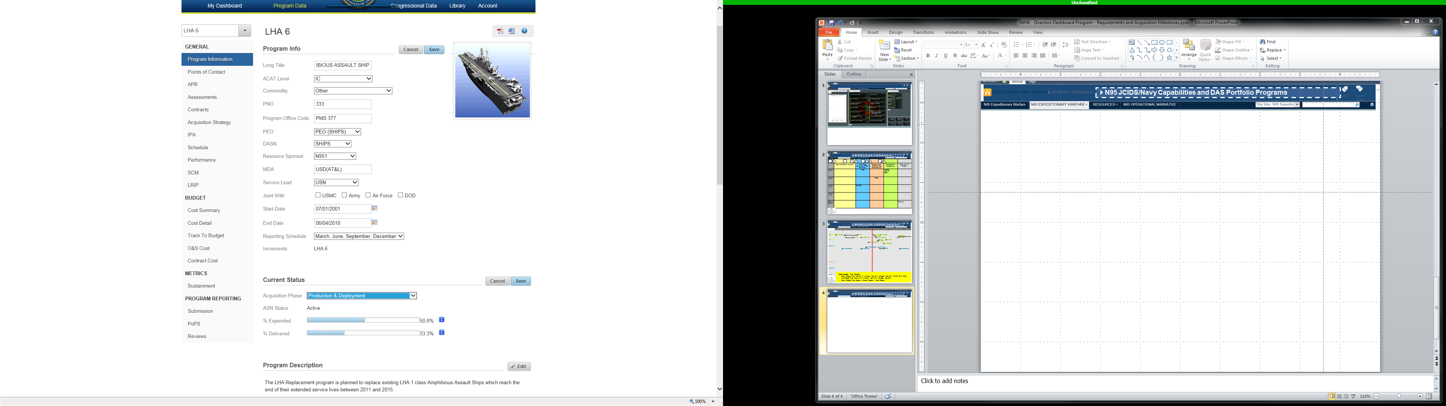
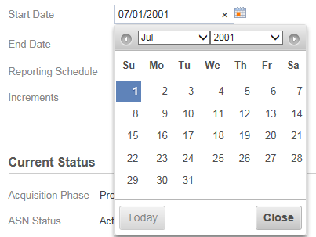
N95 JCIDS/Navy Capabilities and DAS Portfolio Programs Data Entry
LHA(R)
Material Solutions Analysis
Technology Maturation & Risk Reduction
LHA 7
Engineering & Manufacturing Development
LHA 8
Production & Deployment
N953
Operations & Support
Event
Event
Decision Point
Milestone Decision
Requirements Authority Review
Requirements Document
Symbol
= Event Not Started or Complete
= Event Complete
= Decision Point Not Started or Complete
= Decision Point Complete

